Slide 1

Land Registry Smart Contract (Blockchain Based)
Presented by Rishi Kakkar
Uttaranchal University| B.Com (Hons.)

Slide 2

PROBLEM STATEMENT
Corruption, Fraud and Inefficiencies in traditional land records
Fake Documents, Illegal Transfers & Bureaucratic Delays
Middlemen Increase Transaction Costs & Reduce Transperancy

Slide 3
Blockchain-Based Land Registry Smart Contract The Blockchain-Based Land Registry Smart Contract seeks to transform the conventional land registration process by leveraging blockchain technology to create a secure, transparent, and tamper-proof system for managing property ownership. This innovative solution introduces a streamlined approach to registering, transferring, and verifying land ownership through the use of smart contracts. By doing so, it addresses and eliminates many of the persistent problems associated with traditional systems, including fraud, corruption, and inefficiencies, paving the way for a more reliable and efficient land management framework.

Slide 4

WHO ARE THE END USERS?
1. Landowners:
- Secure and transparent system for managing and transferring ownership.
- Eliminates concerns about fraud or document falsification.
2. Buyers:
- Assurance of genuine land availability for sale.
- Transparent and easily verifiable ownership history.
3. Government & Legal Bodies:
- Reduces corruption, fraud, and inefficiency in land transactions.
- Ensures compliance with legal and regulatory processes.
4. Banks & Financial Institutions:
- Clear verification of land ownership records.
- Enables secure lending and financing.

Slide 5

Technology Used
Solidity – Smart contract programming language.
Remix IDE –Web-based Ethereum development environment.
MetaMask – Crypto wallet for contract interaction.
Hardhat/Truffle –Testing and deploying contracts in VS Code.

Slide 6
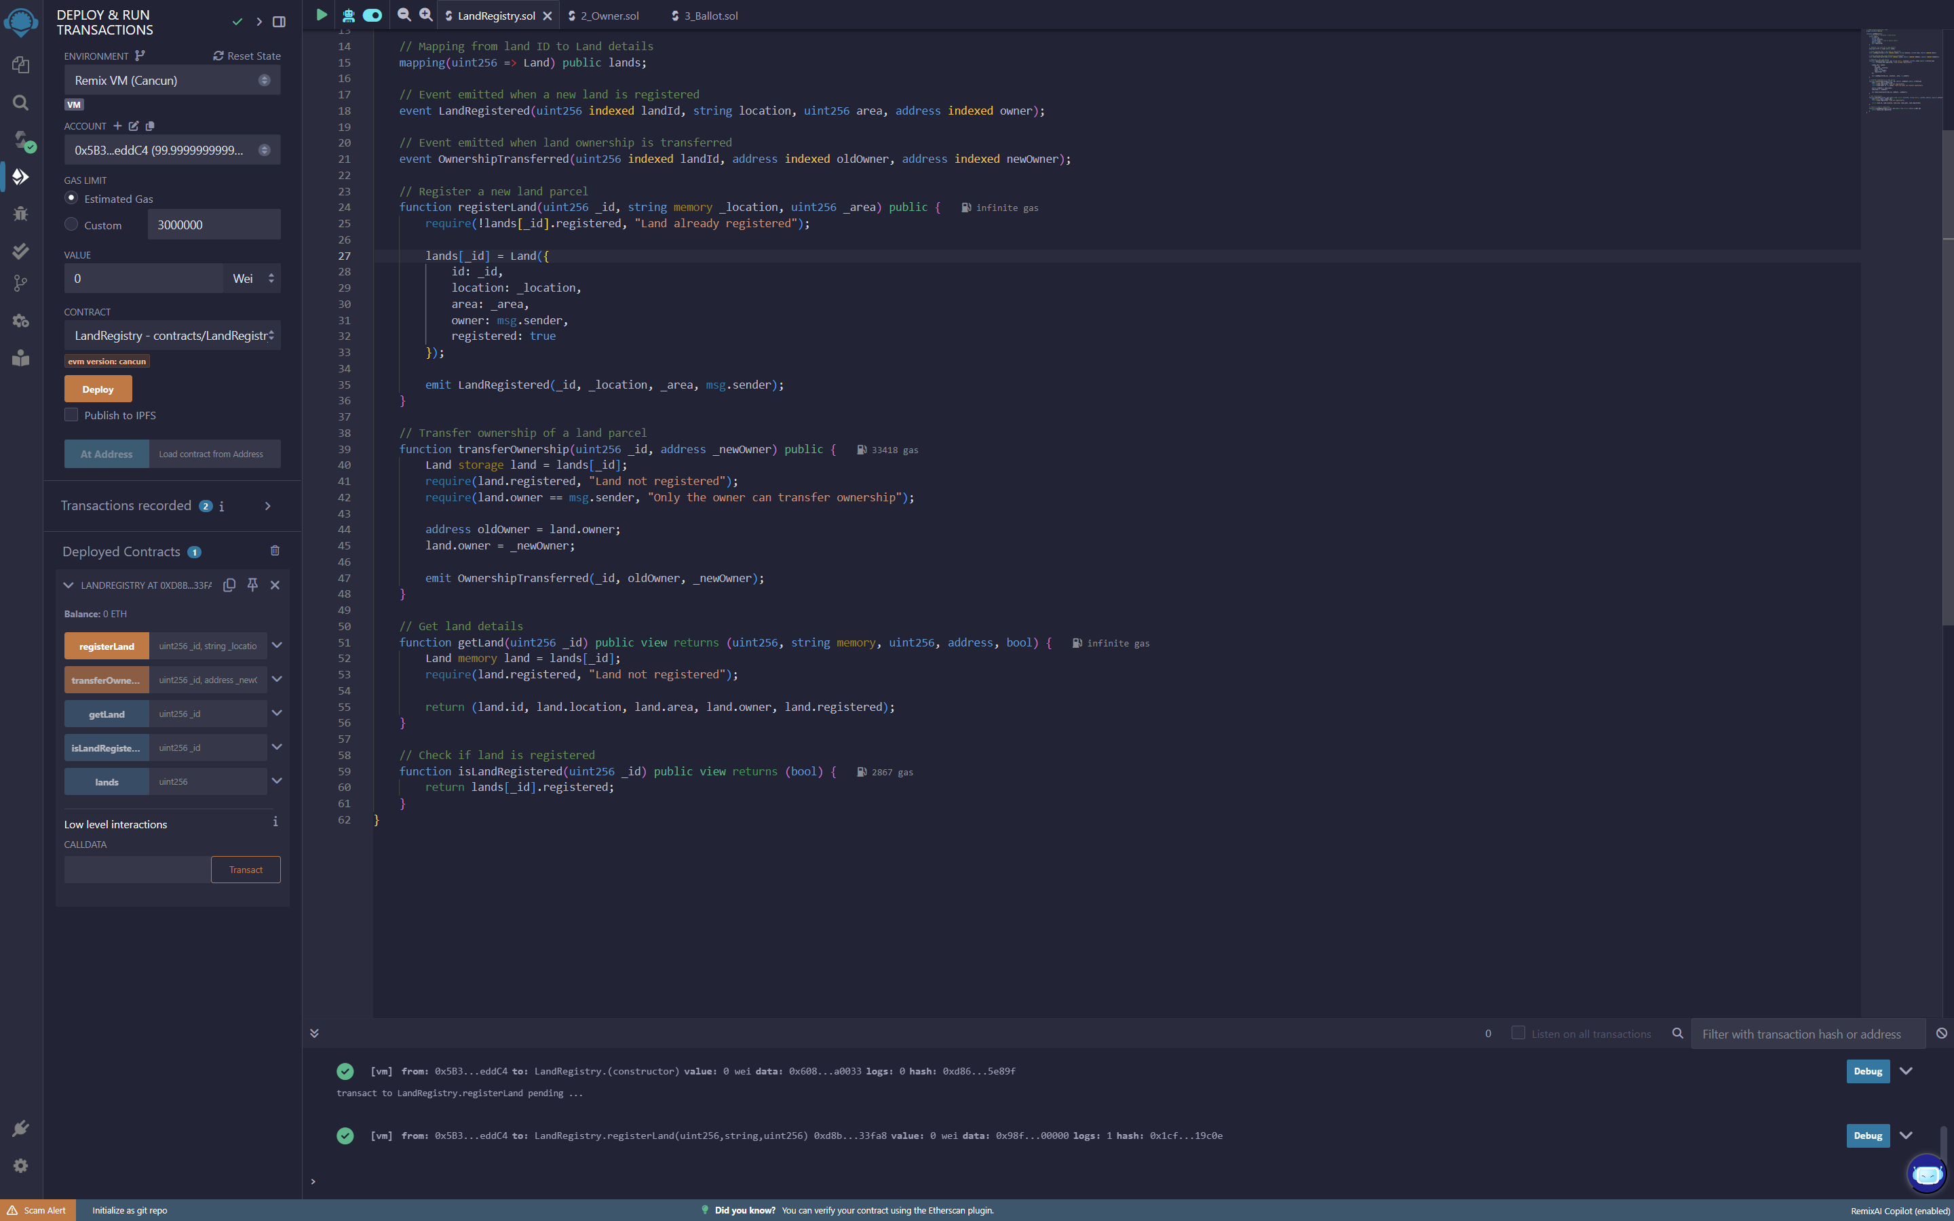
RESULTS
Demo Link

Slide 7
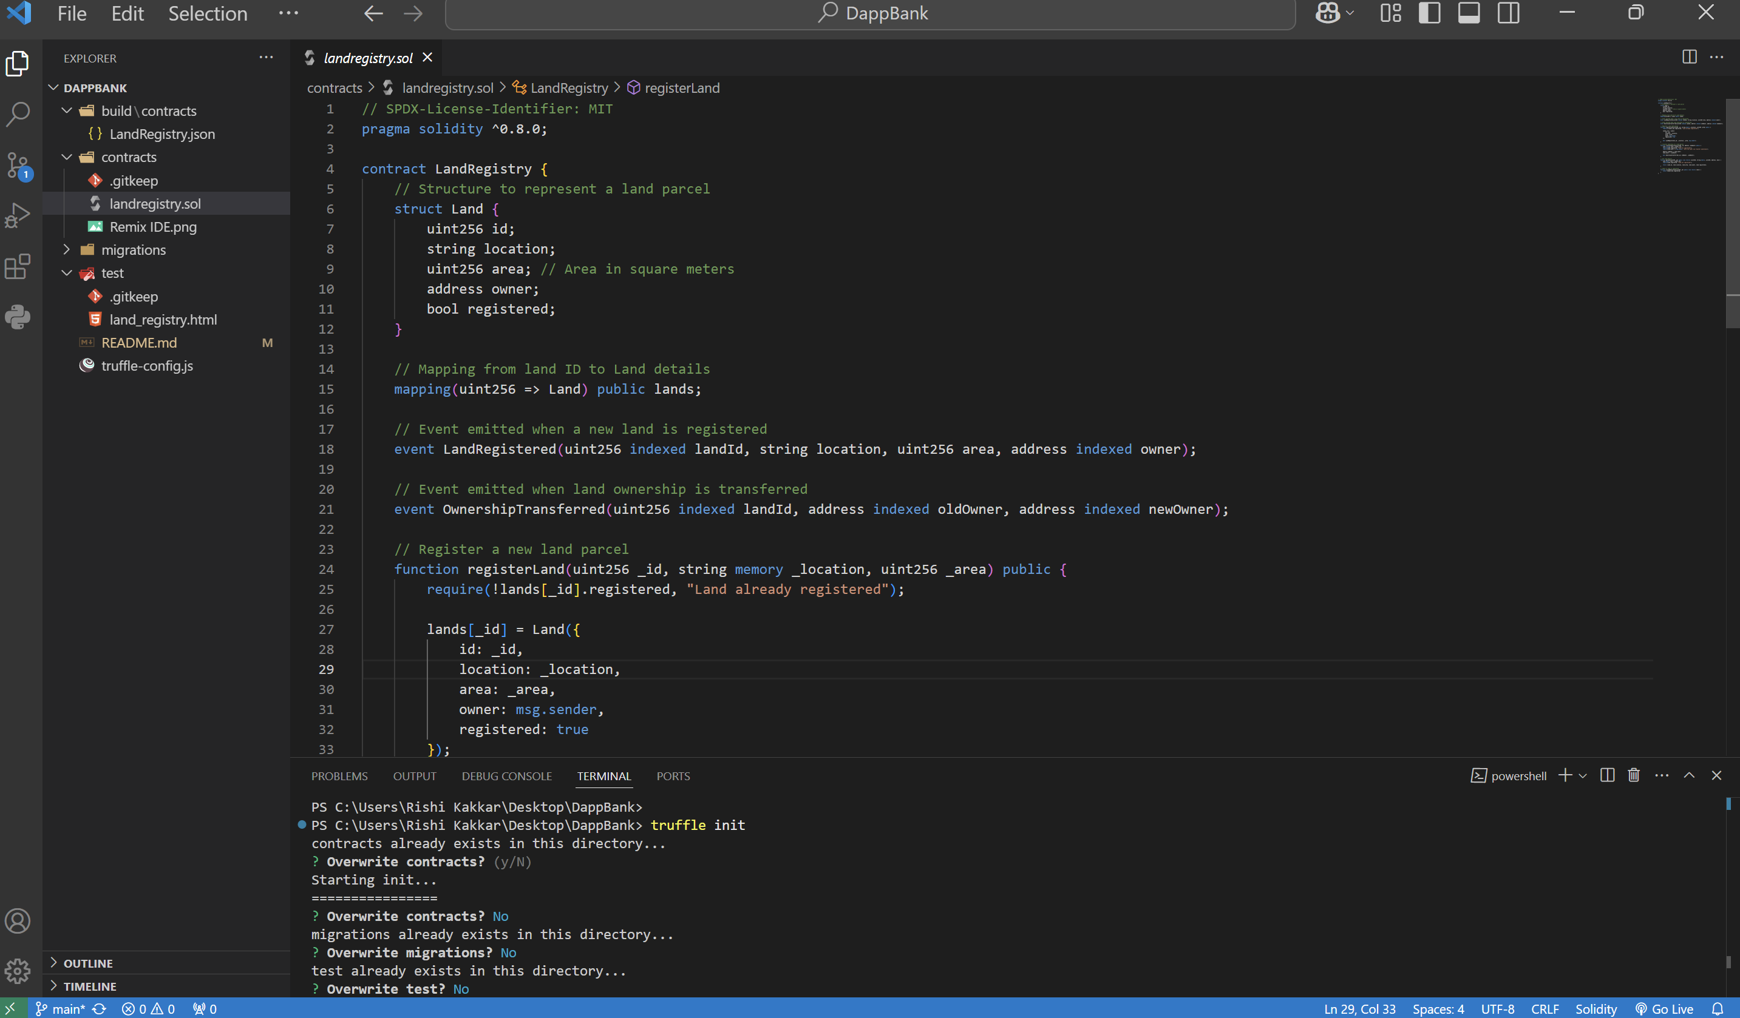
RESULTS
[Add screen shots of your code ]
Demo Link

Slide 8
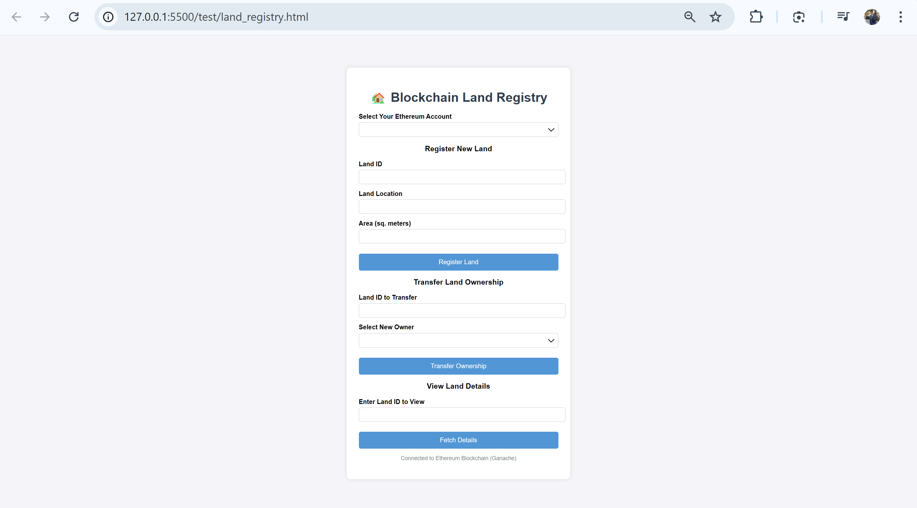
RESULTS
[Add screen shots of your code ]
Demo Link

Slide 9
Demo: Running in Remix IDE
Open Remix IDE – Navigate to Remix IDE, an online Ethereum development environment. It provides a browser-based interface for writing, compiling, and deploying smart contracts.
Copy and Paste the Solidity Contract – Open a new Solidity file in Remix and paste the smart contract code. This contract will define the land registration and transfer functionalities.
Compile and Deploy – Use the Solidity compiler in Remix to compile the contract. Deploy it using Injected Web3 (MetaMask) for live networks or Ganache for a local blockchain simulation.
Interact with Functions – After deployment, interact with the contract by calling functions such as registerLand() to register property ownership and transferOwnership() to transfer land rights securely.
.

Slide 10
Advantages of Blockchain Land Registry
No Paperwork – Blockchain digitizes land records, eliminating the need for physical paperwork. This reduces administrative costs and human errors in documentation.
Tamper-Proof – Ownership records stored on a blockchain are immutable and cryptographically secured, preventing unauthorized alterations or fraudulent claims.
Cost-Effective – Traditional land transactions involve multiple intermediaries (lawyers, brokers, government officials), increasing costs. Blockchain automates these processes, reducing fees.
Fast Transactions – Land transfers that usually take weeks due to bureaucracy can be completed in minutes using smart contracts, ensuring instant and transparent ownership changes.
.

Slide 11
Future Scope
Government Adoption – Governments worldwide can integrate blockchain into national land registries, ensuring transparency and reducing land disputes caused by manual record-keeping.
NFT-based Land Ownership – Real estate can be tokenized as Non-Fungible Tokens (NFTs), allowing for digital proof of ownership and seamless transactions across blockchain networks.
AI-powered Fraud Detection – Artificial Intelligence (AI) can analyze land records to detect duplicate or fraudulent entries, ensuring a more secure and reliable registry system.
Interoperability – Blockchain-based land registries can be linked with Decentralized Finance (DeFi) and mortgage platforms, enabling seamless integration of land ownership with financial services like loans and collateralization.
.

Slide 12
Conclusion
Secure & Transparent – Blockchain-based land registry ensures tamper-proof and transparent transactions, reducing disputes and unauthorized alterations.
Fraud Prevention & Efficiency – By eliminating fraud, inefficiencies, and middlemen, blockchain enhances trust and streamlines land ownership processes.
Revolutionizing Real Estate – A transformative step towards modernizing real estate transactions, making property dealings faster, safer, and more cost-effective with blockchain technology.
.

Slide 13
Thank you
Presented by : Rishi Kakkar
Uttaranchal University| B.Com. (Hons.)
.
.

